Slide 2
Challenges for the Future
Lexical Semantics
Comparisons at word level
Compare and Contrast
Comparisons at document level
Contrasts in addition to comparisons
More Modalities
Words, Documents → Pictures, Audio, Video, etc.
Filter Bubbles
Comparable Corpora can help us get beyond Anglocentric Biases

Slide 3
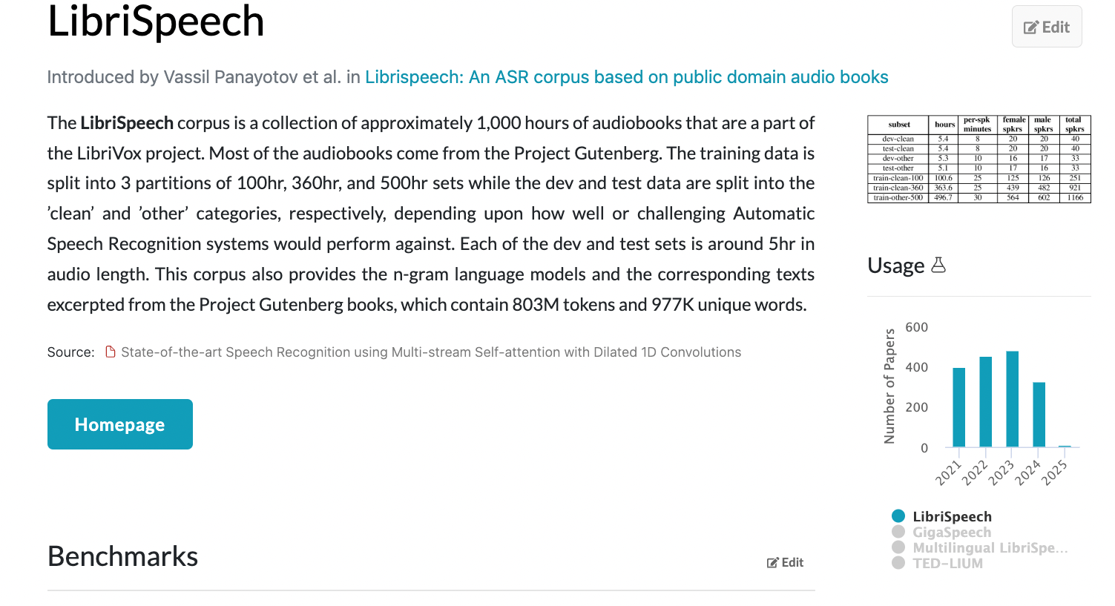
Multimodal Corpora: Text, Audio, Pictures, Video, etc.
A Multimodal Parallel Corpus
A Multimodal Comparable Corpus
Now that everything is a vector,
represent everything as vectors
answer all questions with ANN

Slide 4
Computational Linguistics & Vision Words, Documents → Pictures, Audio, Video, etc.
Perspective: Comparable Corpora
Perspective: Linguistics in Pictures
Now that everything is a vector,
represent everything as vectors
answer all questions with ANN
Data is data
English/French/Audio/Pictures
Communication is communication
Bias/Filter-Bubbles
Translation-Free
Perspective/Sentiment/Stance/Culture
COCO (facts) 👎
ArteLingo (opinions) 👍
Vocabulary
COCO (nouns you can see)
ArteLingo (richer vocab beyond what you can see)
Bounding Box Semantics 👎
Limit language to classifying pixels in a single box
But ambiguity, pragmatics, focus
Bounding boxes: like aligning parallel corpora 👎
(Too) convenient for computation
(Too) limiting to capture the facts

Slide 5
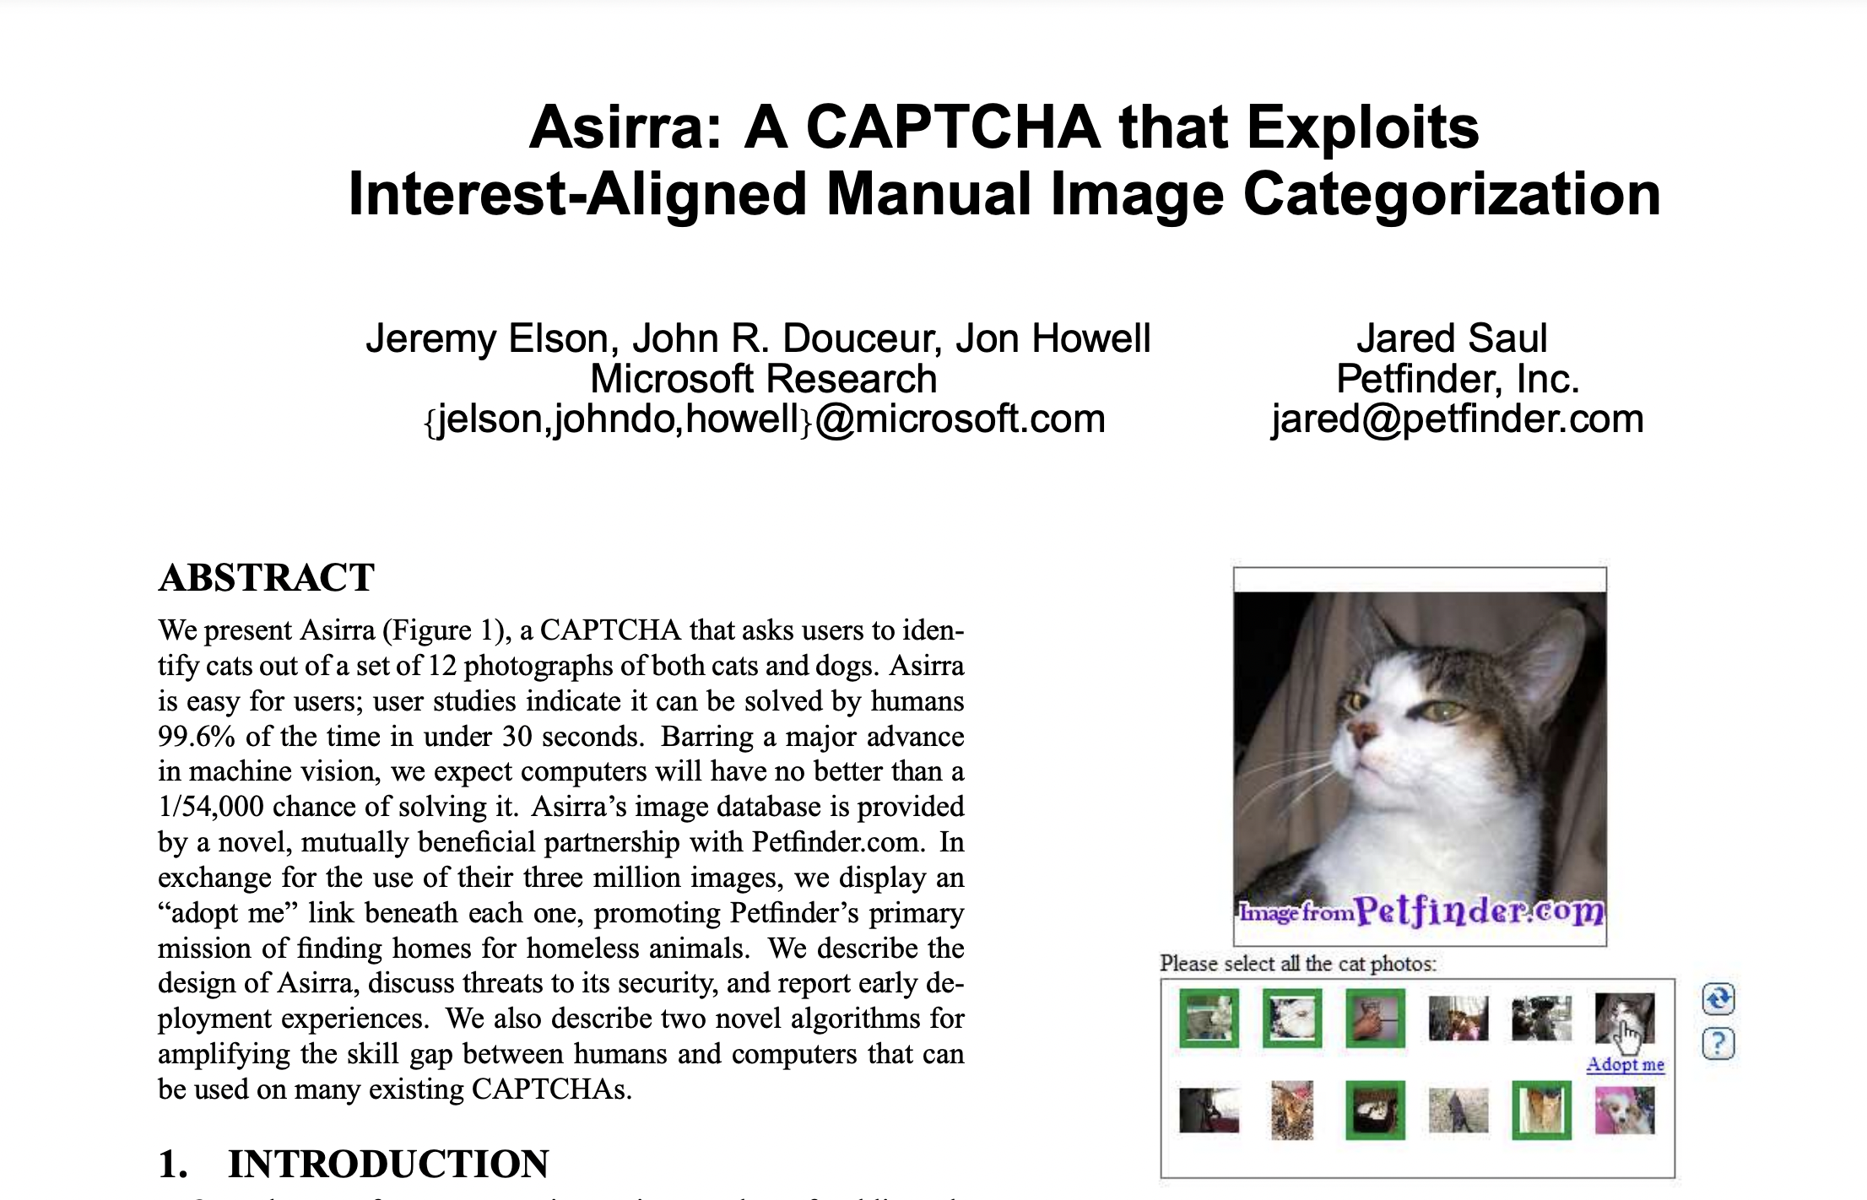
An Older View of Vision Research: Vision = Pixel Classification
https://www.microsoft.com/en-us/research/wp-content/uploads/2007/10/CCS2007.pdf

Slide 6
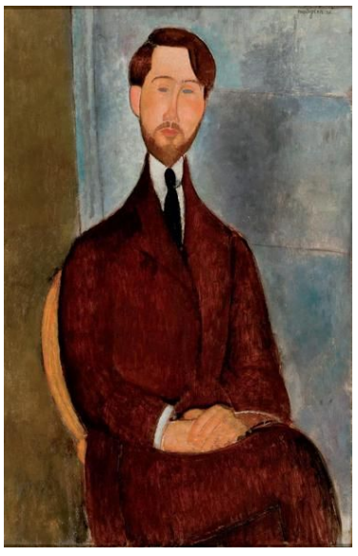
A More Modern View of Vision Research Task: End-to-End Image Captioning
###Human: <img> </img>
Could you describe the contents of this image for me?
Use <lang> words to describe the image
###Assistant:

Slide 7
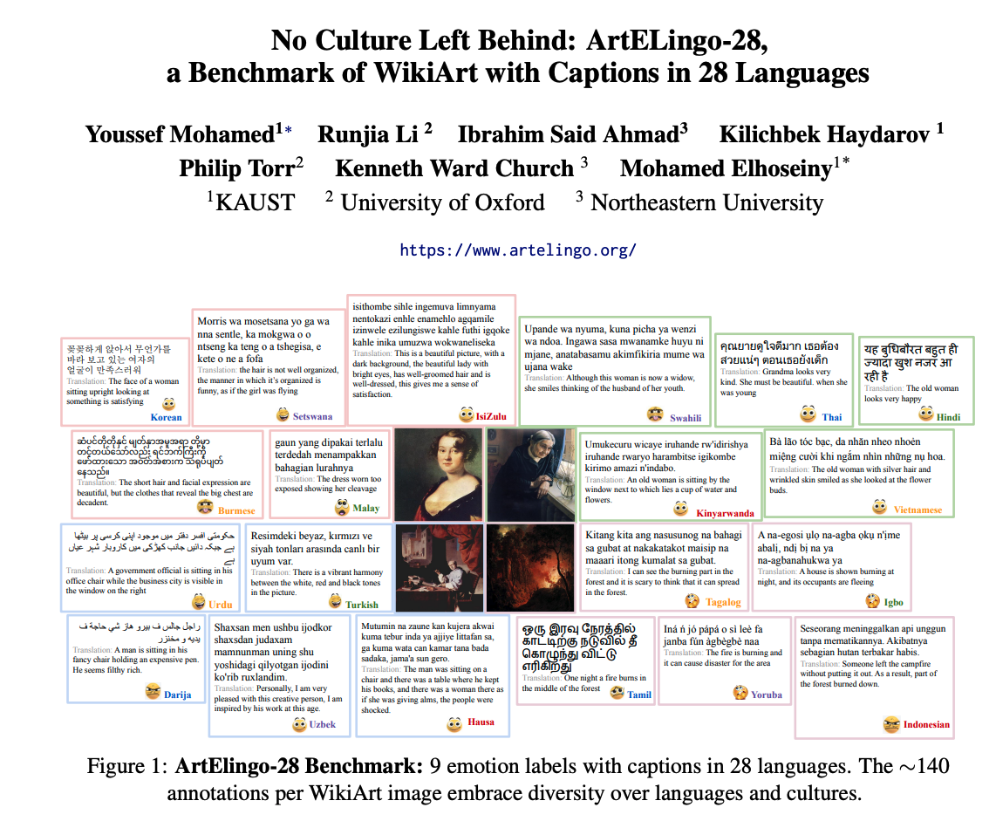
A Translation-Free Benchmark (To avoid Anglo-Centric Biases)
Input:
Picture from WikiArt
Language (one of 28 languages)
Output Annotations:
9 Emotion Labels
4 Positive:
Contentment, Awe, Excitement, Amusement
4 Negative:
Sadness, Anger, Fear, Disgust
1 Neutral
Caption (in your language)
EMNLP-2024

Slide 8
Task for Machine (Similar to Human Annotation Task)
Input:
Picture from WikiArt
Language (one of 28 languages)
Output Annotations:
9 Emotion Labels
4 Positive:
Contentment, Awe, Excitement, Amusement
4 Negative:
Sadness, Anger, Fear, Disgust
1 Neutral
Caption

Slide 9
Embrace Diversity & Multiple Perspectives
emotion labels:
disgust (Burmese)
awe (Malay)
captions focus
on chest
Burmese & Malay
on face and hair
Korean & Setswana
Hypothesis:
Predictable
Ethics Review

Slide 10
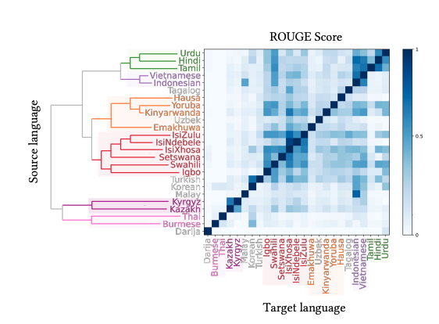
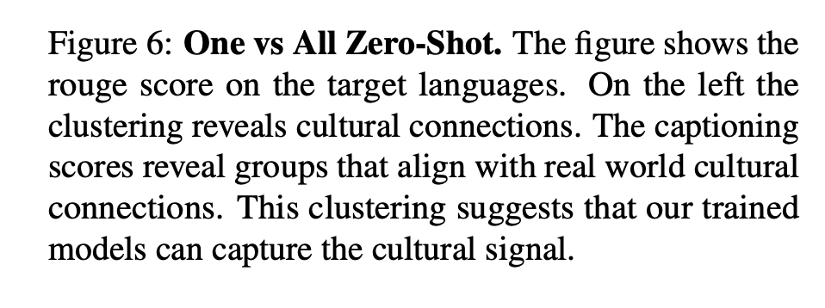
Evidence:
Predictable

Slide 11
Vision: More than Pixels Communication (Shannon): Audience Matters
Art is a form of communication
between artist and audience
Background matters
Language
Culture
Task: Art, Lang → Caption
English pivot baseline:
Translate caption from English
Can we beat that?

Slide 12
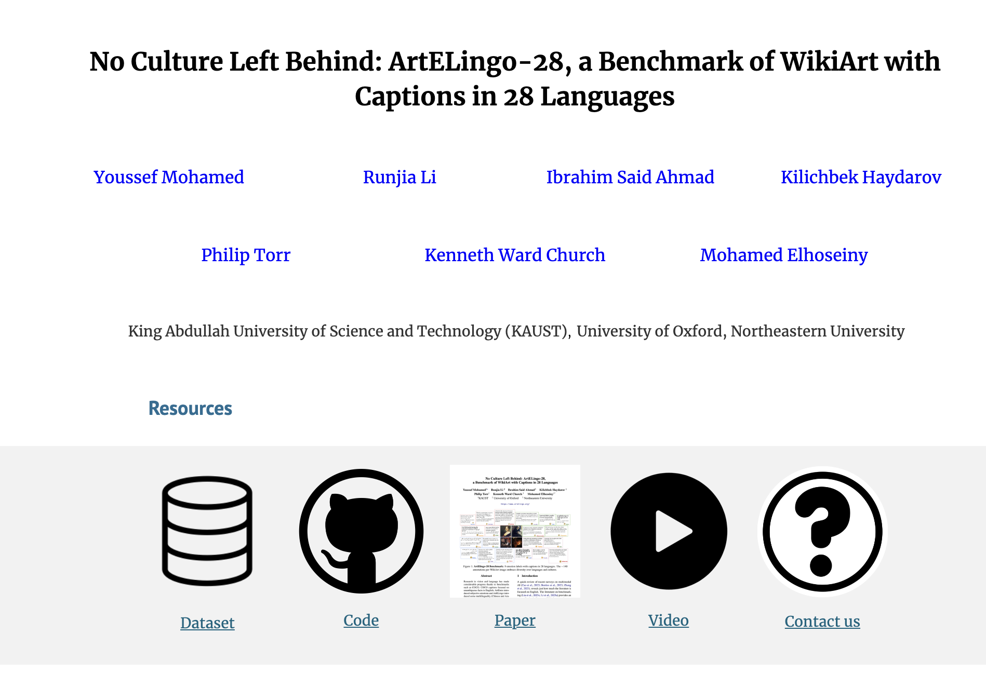

Website: Benchmark, Code, Paper & Video

Slide 13
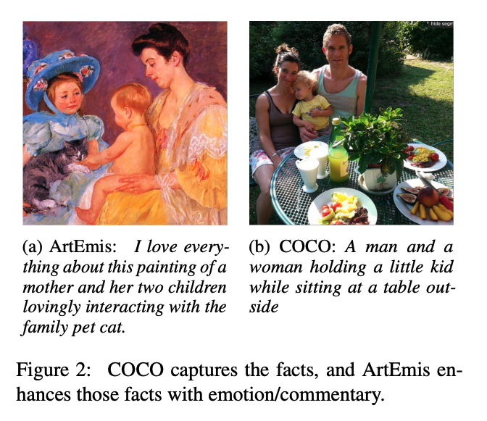
Adding Perspective to Speech/Vision Research COCO (Objective) → ArtEmis (Subjective)
Subjective Emotion
Objective
Facts
More room for Audience Background:
Culture/Language
Nouns: man, woman, kid, table
Modifiers: love, interacting, family

Slide 14
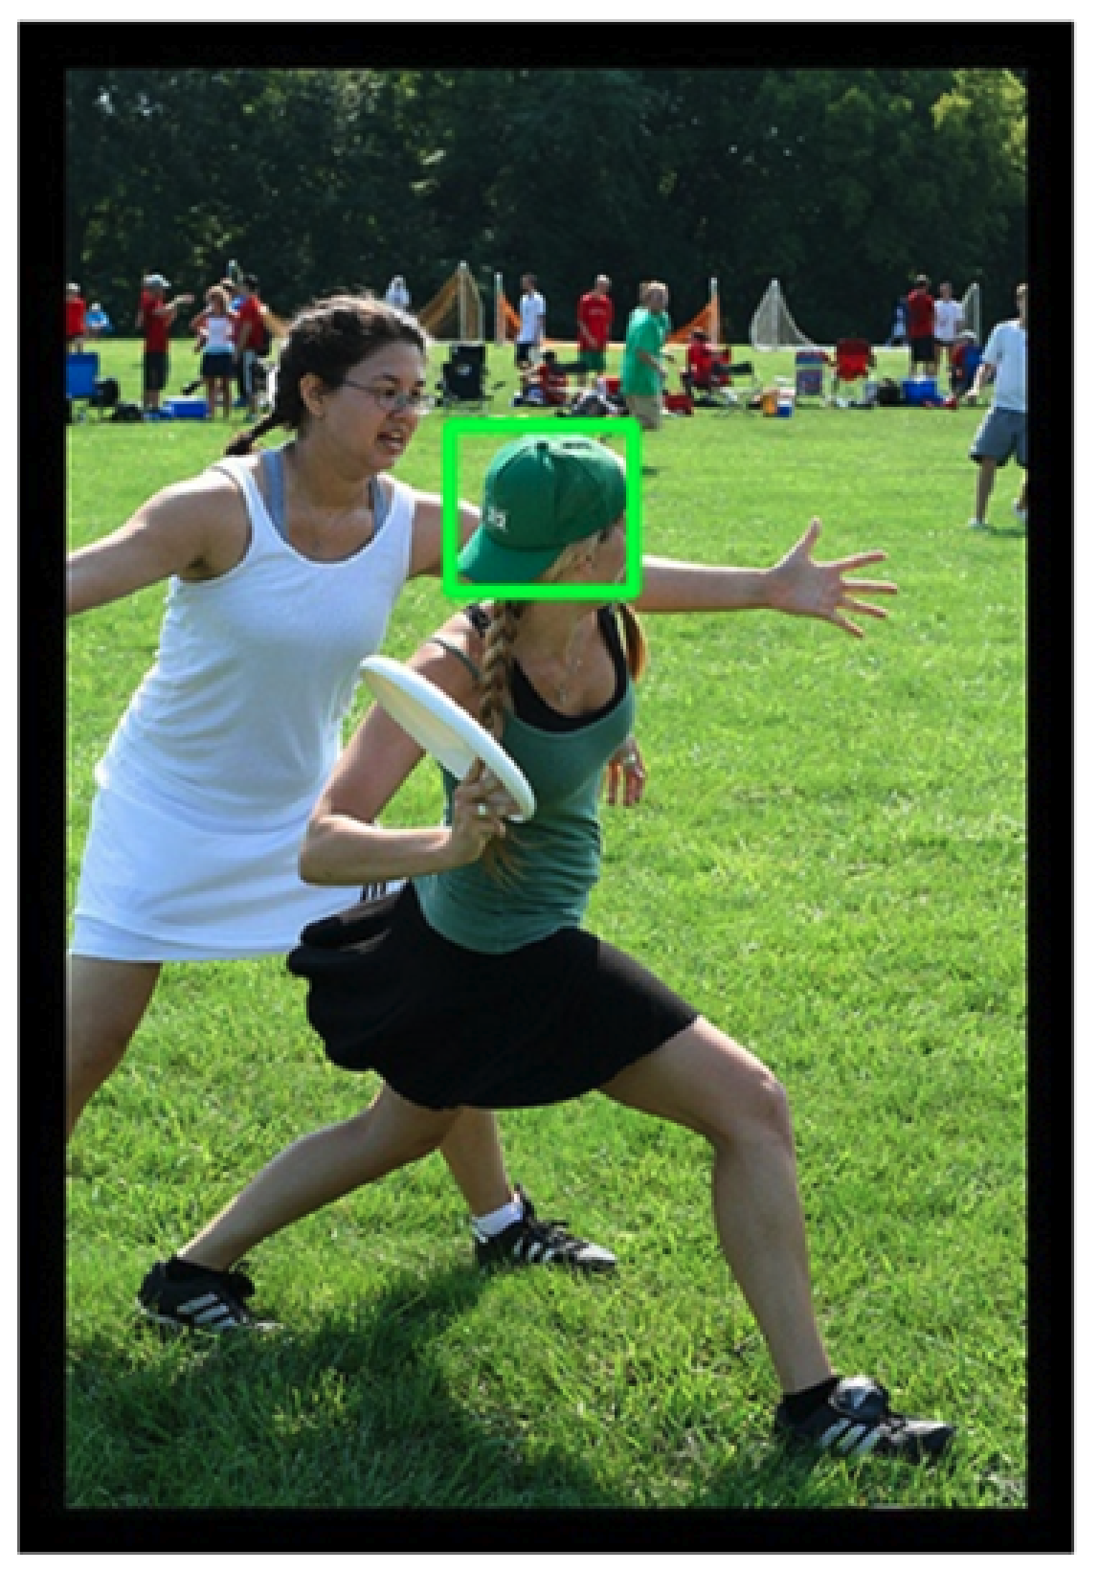
Pragmatics
Candidate labels: baseball cap, cap, green hat, hat, head.
Can you guess which one is in the gold standard?
Head is weird
Because it serves no useful purpose to mention that.
(You might mention that if one of the girls were headless)
Purposes of modification (Grice)
Descriptive
Discrimination
Green vs. White
Hat vs. No Hat
Offense vs. Defense
One Bounding Box vs. Two?
One: describe what is inside the box
Two: compare and contrast

Slide 15
Focus/Emphasis/Composition: Foreground vs. Background
Focus (leading role): Frisby, Throw, Offense
Supporting role: Defense
Background: Spectators
Photographer tells us
what’s central
and what isn’t

Slide 16
Verbs, Subjunctive, Focus, Perspective, etc…
Pictures vs. Videos
Captions on pictures have more nouns (you can see):
girl with green hat
Captions on videos have more verbs:
girl throwing frisbee
Possible Worlds: Subjunctive, Hedges
The girl on defense might block the throw,
but probably won’t
Bounding boxes discourage editorializing
Few words not explicitly grounded to a single box
Few opinions, comparisons, contrasts, predicates (verbs/adjectives), possible worlds
Bounding boxes are like aligning parallel corpora
(Too) convenient for computation
(Too) limiting to capture the facts

Slide 17
More Predicates/Perspectives (without boxes) (Predicates = Verbs/Adjectives)

